Slide 1
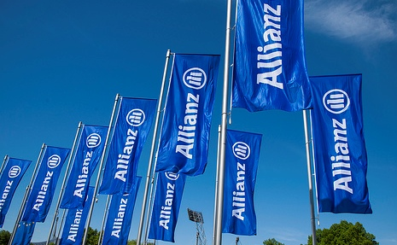

ALLIANZ INITIAL LEARNING PROGRAM
RAVEENA RAVIKUMAR/ MIS(SAS) / 20-11-2017

Slide 2
Content Topics
01 | ALLIANZ AT A GLANCE | 05 | APPLICATION & TOOLS
02 | Key learnings | 06 | DATA WAREHOUSE
03 | PROJECT-Web development | 07 | SAS LEARNINGS
04 | Screenshots | 08 | PARTICIPATION

Slide 3
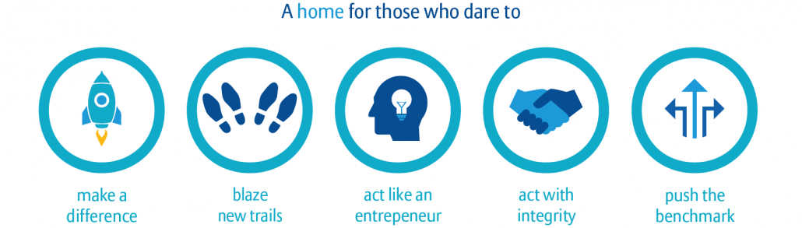
01
Allianz

Slide 4
Key learnings 02
Corporate Induction
Java
Oracle
HTML
TESTING
Security Practices
JSP
SQL
Java Database Connectivity
TECHNOLOGIES LEARNED
SESSIONS ATTENDED
Insurance Basics
Java
Oracle
HTML
Types of testing
JSP
SQL
Java Database Connectivity
Servlets
Campus to Corporate
Corporate Induction
Divisional Induction
Security Practices
Testing Sessions
Business Analyst Session

Slide 5
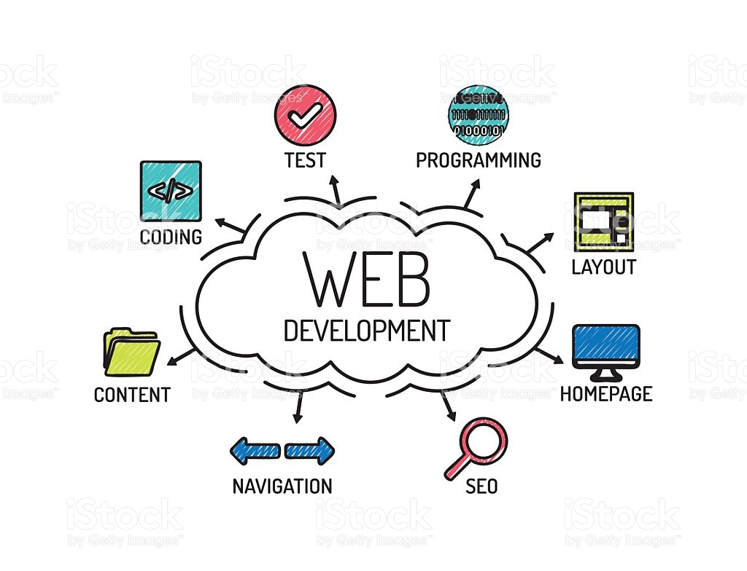

Slide 6
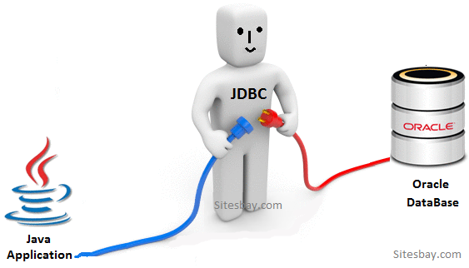
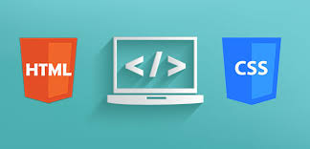
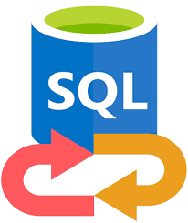
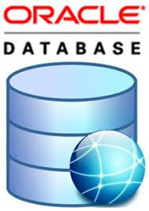



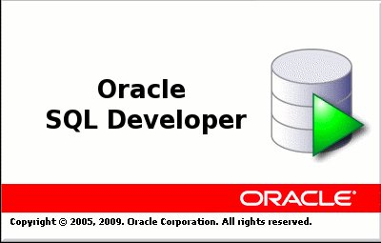
WEB BUILDING BLOCKS 03

Slide 7
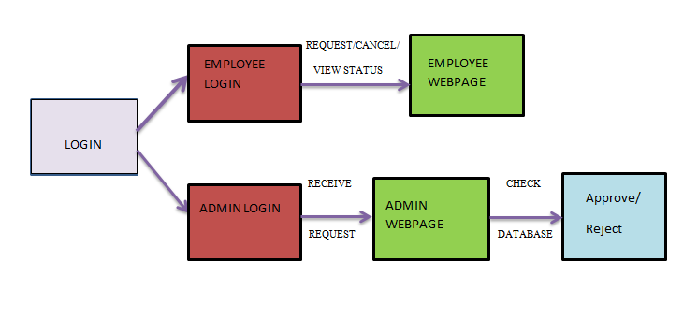
LEAVE MANAGEMENT SYSTEM 04

Slide 8
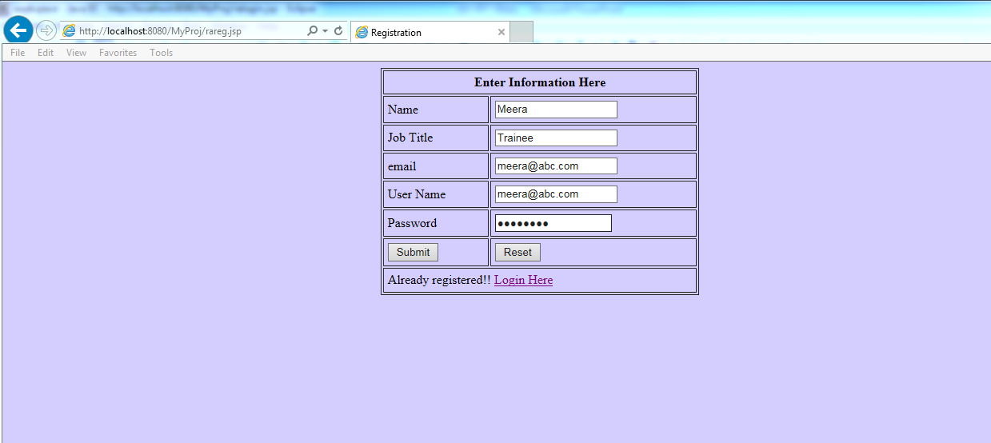
Screenshots 05

Slide 9
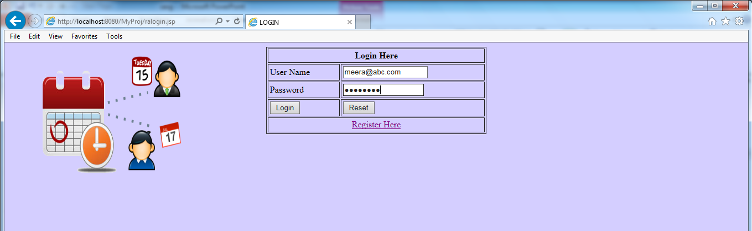
LOGIN PAGE

Slide 10
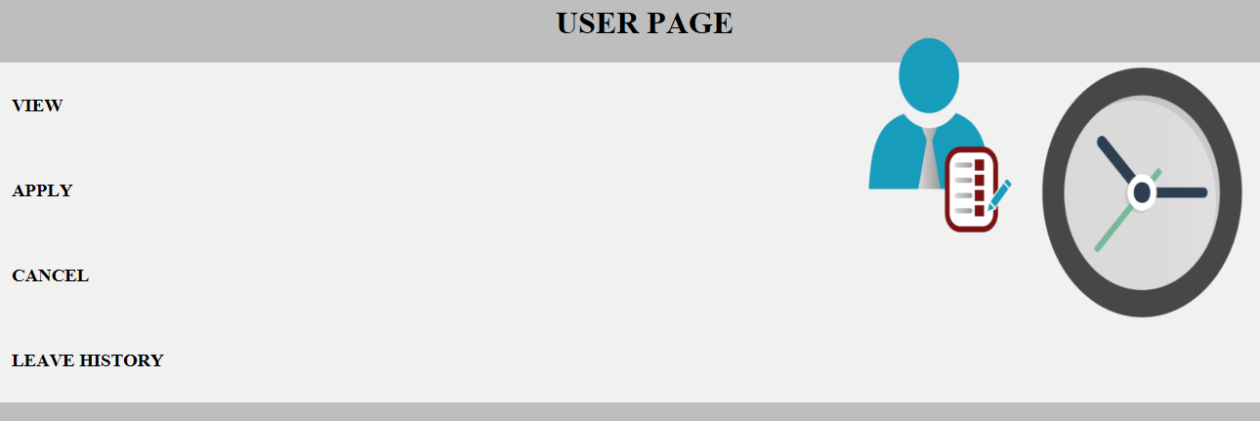
Employee page

Slide 11
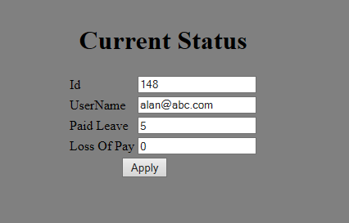
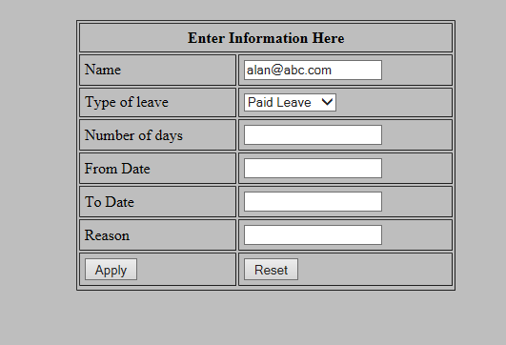
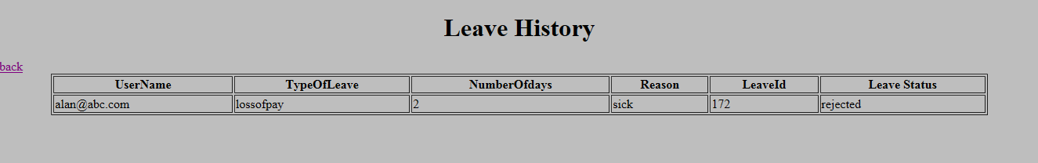
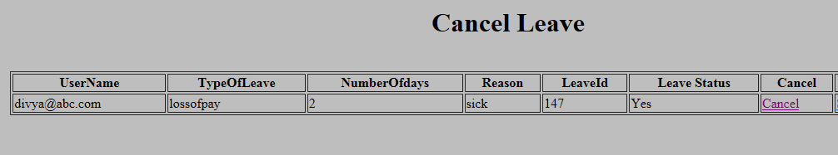
EMPLOYEE FEATURES

Slide 12
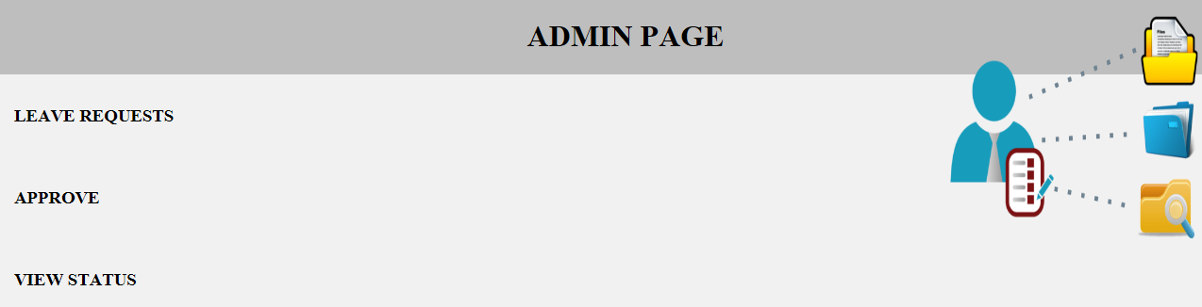
ADMIN PAGE
Admin page

Slide 13
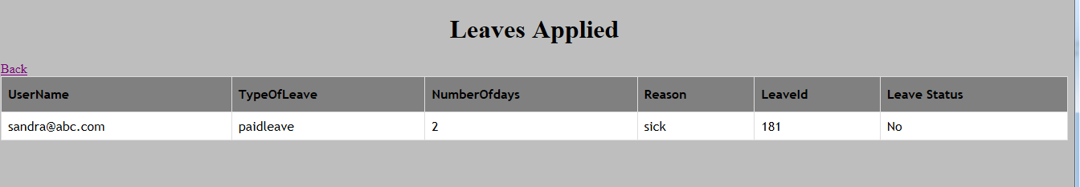
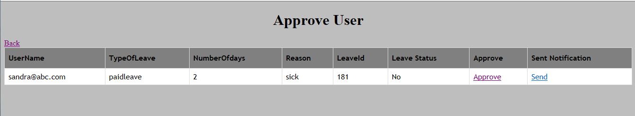
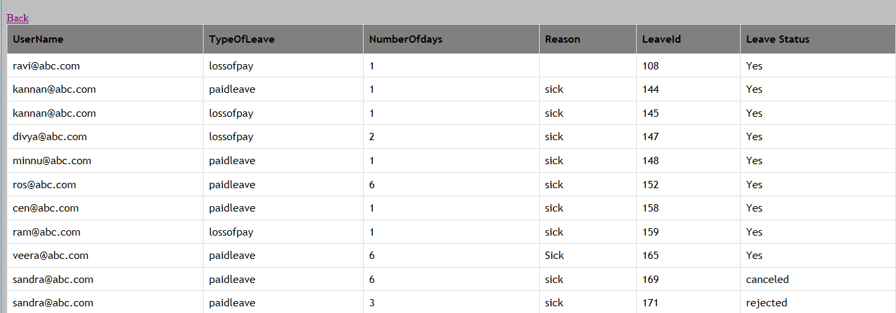
ADMIN FEATURES

Slide 14
Cmis tEAM

Slide 15
Corporate MANAGEMENT INFORMATION SYSTEMS (MIS)
Previously known as
“Data warehouse Team”
Often known as
“SAS Team”
Officially known as
“Corporate MIS Team

Slide 16
CMIS Team-who are we?
MIS Team focuses on the management of operational systems data which helps in efficient and effective strategic decision making.
MIS plays a pivotal role in the organization and creates an impact on the organization’s functions, performance and productivity.
For taking rational decision, timely and reliable information is essential and is procured through a logical and well-structured method of information collecting, processing and disseminating to
decision makers.

Slide 17
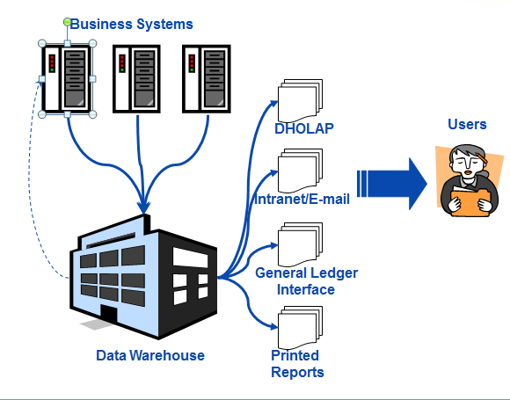
How it works in allianz

Slide 18
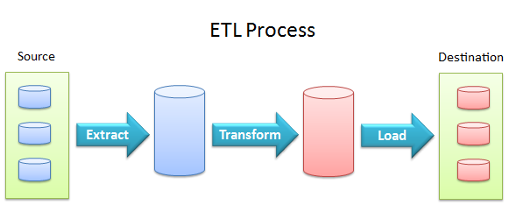
ETL PROCESS

Slide 19
A data warehouse is a subject oriented, integrated, time variant and non volatile collection of data in support of management’s decision making process” - Bill Inmon Recognized as the "father of the data warehouse"
DATA WAREHOUSE

Slide 20
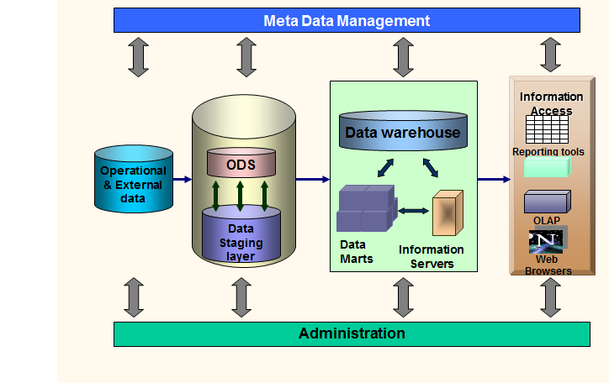
DATA WAREHOUSE ARCHITECTURE

Slide 21
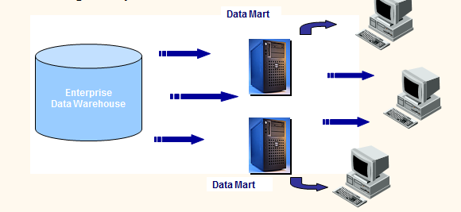
DATA MARTS
Data mart is a decentralized subset of data found either in a data warehouse or as a standalone subset designed to support the unique business unit requirements of a specific decision-support system.

Slide 22
SAS
“SAS is an integrated software providing complete control over
data access, management, analysis and presentation”.
- SAS Institute

Slide 23
Some technologies where the SAS System is used
Data Warehousing
Business Intelligence/OLAP
Applications Development
Data Mining
Statistical Analysis
Web Enablement
Client Server

Slide 24
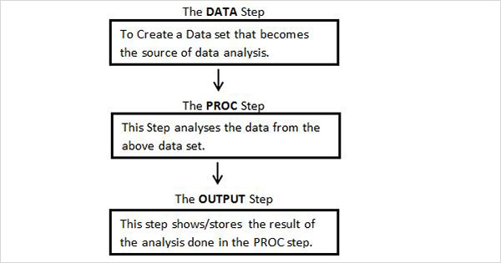
Basic structure of sas programs

Slide 25
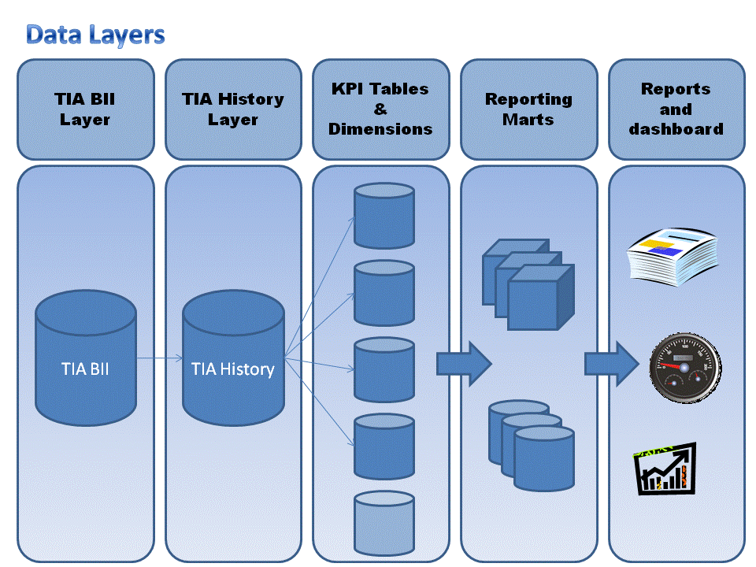
warehouse model for TIA

Slide 26
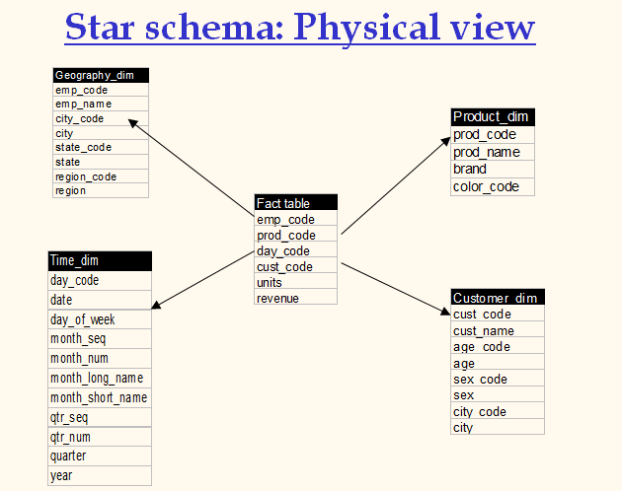

Slide 27
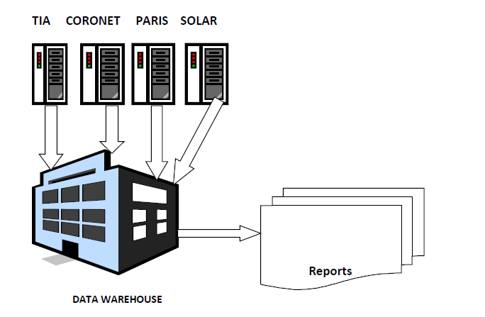
current Data Warehouse

Slide 28

PARTICIPATION

Slide 29
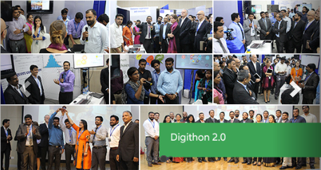

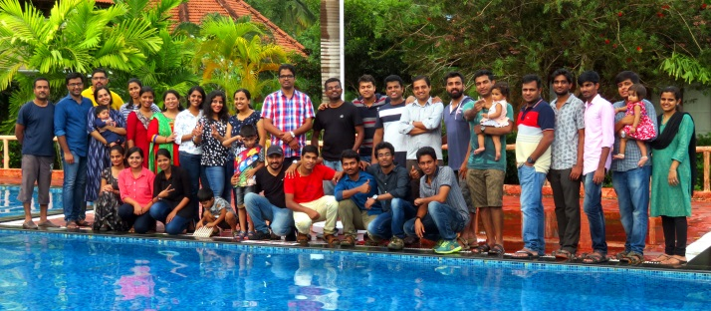
DIGITHON 2.0
Sparsh 2017
FASHION WALK
DANCE
TEAM OUTING

Slide 30


